Slide 1
BCSE306
Artificial Intelligence
Dr.Priyanka N
Assistant Professor
School of Computer Science and Engineering (SCOPE),
VIT Vellore,
Priyanka.n@vit.ac.in

Slide 2
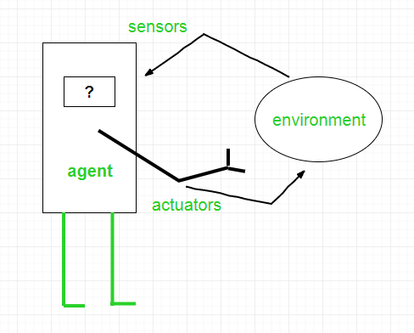
THE STRUCTURE OF AGENTS
Architecture is the machinery that the agent executes on. It is a device with sensors and actuators.
Agent program is an implementation of an agent function.
An agent function is a map from the percept sequence to an action.
Agent = Architecture + Agent Program

Slide 3
Types of Agents
Agents can be grouped into five classes based on their degree of perceived intelligence and capability :
  Simple Reflex Agents
  Model-Based Reflex Agents
  Goal-Based Agents
  Utility-Based Agents
  Learning Agent

Slide 4
Simple reflex agents
Simple reflex agents ignore the rest of the percept history and act only based on the current percept.
Percept history is the history of all that an agent has perceived to date.
The agent function is based on the condition-action rule. A condition-action rule is a rule that maps a state i.e., a condition to an action.
If the condition is true, the action is taken, or it is not. This agent function only succeeds when the environment is fully observable.
For simple reflex agents operating in fully observable environments, infinite loops are often unavoidable.

Slide 5
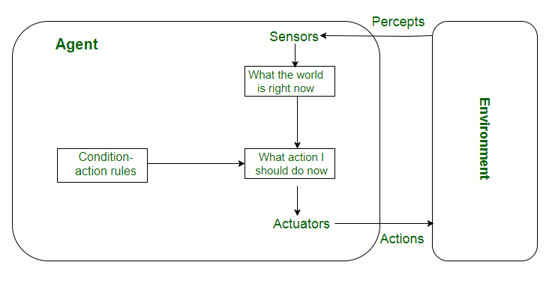
It may be possible to escape from infinite loops if the agent can randomize its actions.
Problems with Simple reflex agents are :
  Minimal intelligence.
  No knowledge of non-perceptual parts of the state.
  Usually too big to generate and store.
  If there is any change in the environment, then the collection of rules needs to be updated.

Slide 6
Model-based reflex agents
It works by finding a rule whose condition matches the current situation.
A model-based agent can handle partially observable environments by the use of a model about the world.
The agent has to keep track of the internal state which is adjusted by each percept and that depends on the percept history.
The current state is stored inside the agent which maintains some kind of structure describing the part of the world which cannot be seen.
Updating the state requires information about :
  how the world evolves independently from the agent, and
  how the agent’s actions affect the world.
Notes:
12

Slide 7
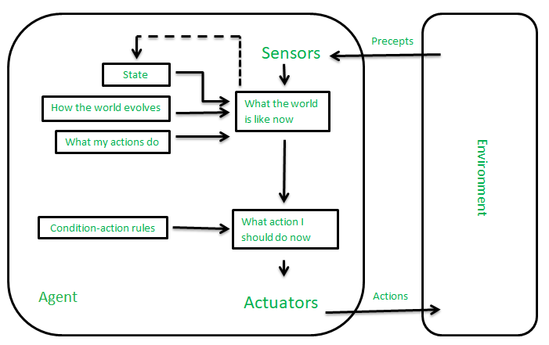
Model-based reflex agents

Slide 8
Goal-based agents
These kinds of agents take decisions based on how far they are currently from their goal(description of desirable situations).
Their every action is intended to reduce its distance from the goal.
This allows the agent a way to choose among multiple possibilities, selecting the one which reaches a goal state.
The knowledge that supports its decisions is represented explicitly and can be modified, which makes these agents more flexible. They usually require search and planning.
The goal-based agent’s behavior can easily be changed.

Slide 9
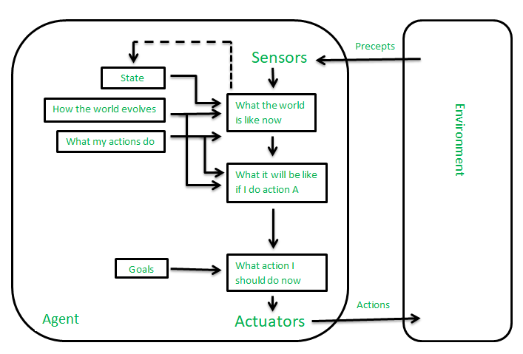
Goal-based agents

Slide 10
Utility-based agents
The agents which are developed having their end users as building blocks are called utility-based agents.
When there are multiple possible alternatives, then to decide which one is best, utility-based agents are used.
They choose actions based on a preference (utility) for each state.
Sometimes achieving the desired goal is not enough. We may look for a quicker, safer, cheaper trip to reach a destination. Agent happiness should be taken into consideration.
Utility describes how “happy” the agent is. Because of the uncertainty in the world, a utility agent chooses the action that maximizes the expected utility.
A utility function maps a state onto a real number which describes the associated degree of happiness.

Slide 11
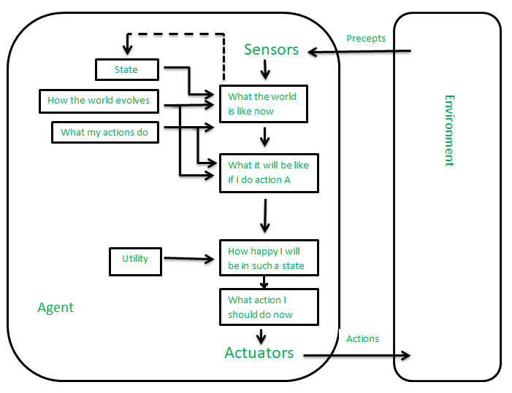
Utility-based agents

Slide 12
Learning Agent
A learning agent in AI is the type of agent that can learn from its past experiences or it has learning capabilities. It starts to act with basic knowledge and then is able to act and adapt automatically through learning.
A learning agent has mainly four conceptual components, which are:
Learning element: It is responsible for making improvements by learning from the environment
Critic: The learning element takes feedback from critics which describes how well the agent is doing with respect to a fixed performance standard.
Performance element: It is responsible for selecting external action
Problem Generator: This component is responsible for suggesting actions that will lead to new and informative experiences.

Slide 13
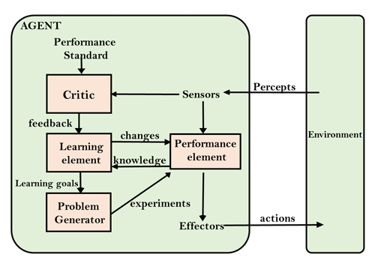
Learning Agent

Slide 14
THANK YOU

